Slide 1
PnP Transformation Process
Name
Title
Company
Notes:
Introduction to the PnP Transformation Process

Slide 2










Why transition to SharePoint App/add-in Model?
IT Pro’s
Scalable Solution
Align with service roadmap
Agile and faster deployment
You control release process
Cloud Enabled
Developers
Open APIs
Responsive UI
Cross-Device
Social
Security
Notes:
Full trust solutions have implications on Disaster Recovery Model
Full trust solution deployments cause downtime
Full trust solutions have to be closely analysed and “trusted”
Sandbox solutions are deprecated

Slide 3

Why would you take advantage of the PnP Transformation program?
Modernize your custom SharePoint applications
Take advantage of new features and benefits of the standard SP app/add-in model
Enhance your existing custom solutions by leveraging the power of the SP app/add-in model
Leverage available community IP and expertise
SP app/add-in model is recommended customization pattern for Office 365 and for on-premises
Notes:
High level benefits of the process and reasoning for transition.

Slide 4

SharePoint Customization Recommendations
Full trust code or farm solutions are not recommended
SP app / add-in model recommended also for on-premises
Provider hosted add-ins as recommended approach
Provider hosted add-ins hosted in Azure for Office 365
Notes:
General customization pointers for cloud and on-premises
FTC: Full Trust Code
Office 365 MT: Office 365 Multi Tenant
Align to the cloud service roadmap
Cloud App Model offers new capabilities

Slide 5
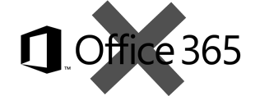
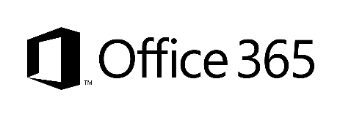
What does “app model” or “add-ins” mean in our terminology?
SharePoint Add-Ins means all operations executed outside of the server
Classic - Full trust solutions
ISV solutions
Client Side Solutions
Remote provisioning for elements
Store and corporate catalog
App catalog based solution
Custom service applications
Custom WCF services
Platform level customizations to on-premises
Server side controls as JavaScript on page layouts and master pages
Embracing un-ghosted model
SP App dimension with provider hosted apps to provide new capabilities
Packaged reusable solutions built for specific functionality
SharePoint customizations, not customer specific customizations
Customer specific customizations
Not only for market place or store, but also as platform for customer specific customizations
Notes:
Just to clear out hat the app model / add-in model means in Microsoft terminology.
Key pointer to land is that there’s two types of apps… typical apps in Store and in corporate catalog and client side solutions, which remotely either configure SP sites or take advantage of the SP services.
Farm solutions are supported in SP2016, but recommended only for special cases.

Slide 6





Transformation process
Readiness
Assessment
Planning
Implementation
Deployment
Readiness with app model topics
Hosting decisions
Network impact analysis
Development model readiness
ALM model planning
Analyze existing solution usage
Analyze existing code and functionality
Concentrate on business and functional requirements, not on technology
App model solution planning and design
What patterns and models are used for different solutions
What solutions can be converted to out of the box capabilities?
Detailed technical planning
Actual app model solution implementation
Typical development process, including testing
App solution deployment
Existing content retrofitting
Farm solution retraction in on-premises environments
Notes:
Five steps for the Transformation process and the key pointers for each of the steps.

Slide 7
PnP Transformation Process - Deliverables
Readiness
Assessment
Planning
STEP 1
Empower & Plan
App hosting configuration. Leverage available resources to ramp up Dev resources
Analyze solution inventory / requirements and provide guidance on solution modernization
Provide architecture design guidance for selected scenarios
Step 1 provides details on estimating following stages in detail.
Deliverable:
Successfully smoke test app to validate configuration
Deliverable:
Assessment report
Deliverable:
Architecture Design Report
Detailed statement of work for accurate estimates
Implementation
Deployment
STEP 2
Develop & Deploy
Jointly work on development and testing with MS partners
Deploy App solutions
Retract farm solutions
Repeat the process for each solution needed to be transformed.
Deliverable:
Tested solution artifacts
Deployment Guide
Deliverable:
Replace FTC by APP
Project signoff
Notes:
Five steps divided to 2 steps.
We recommend to complete first 3 actions before making detailed estimates for the following steps. This way there’s clarity on the business requirements and future target for the customizations and concentration of the transformation actions is towards the actually needed capabilities. Key step is the assessment and to understand actual business drivers and how the application works from UI perspective. This is not 1 to 1 transformation, we rather concentrate on implementing needed functionalities using app model techniques, which could result completely different kind of implementation, so looking just the existing code is not enough.
You can use assessment tooling like SPCAF during the assessment phase to analyze the existing code and the possible transition approaches.

Slide 8
Factory based model for larger deployments
Application Transformation Factory
Initial Assessment & Rationalization
Detailed Assessment & Planning
Implementation & Deployment
Categorize
Batch 1
Batch 1
Batch 2
Batch 2
Batch n
Prioritize
Batch 2
Solution 1
Batch 3
Solution 1
…
…
Solution 1
…
Batch n
Solution n
Learnings, patterns, practices
Learnings, patterns, practices
Application assessments to define and the financial and technical feasibility of moving an application to app/add-in model, are done based on the combination of:
Using software analysis tool-sets
Application-code and -documentation reviews
Analysis sessions with application owners
Notes:
This shows possible factory based model for larger deployments with significant amount of customizations and applications to transform. Key point is to perform better initial prioritization and categorization for the application, but actual assessment and implementation phases will follow the similar process as with the smaller deployments. Solutions are looped through the process in batches based on categorization. Each iteration and batch will results additional learnings and reusable code, which will help on following batches.
Initial Assessment and Rationalization
Same as Readiness actions (#1) in the Transformation process
Detailed Assessment & Planning
Implementation

Slide 9
Planning Calendar – Getting started
Everybody
Customer Preparedness Workshop 1
Customer Preparedness Workshop 2
Solution assessment functionality demo 1
Solution assessment functionality demo 2
Solution assessment outcome discussion
Solution report outcome discussion
Next Steps
Customer demonstrates the customizations
Focus on App Hosting
Focus on App Development
Share Findings
Propose design
Activity
IT Admin
Developers
Audience
Notes:
Audience might vary based on how the organisation is structured

Slide 10

Questions?

Slide 11
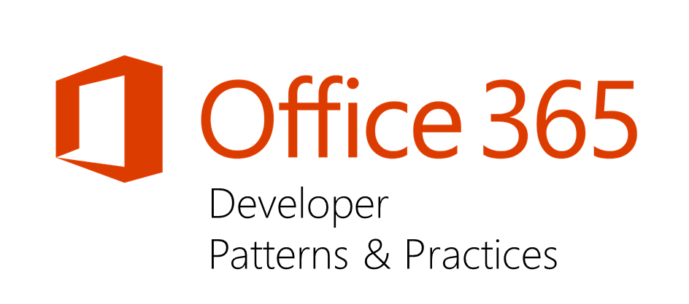
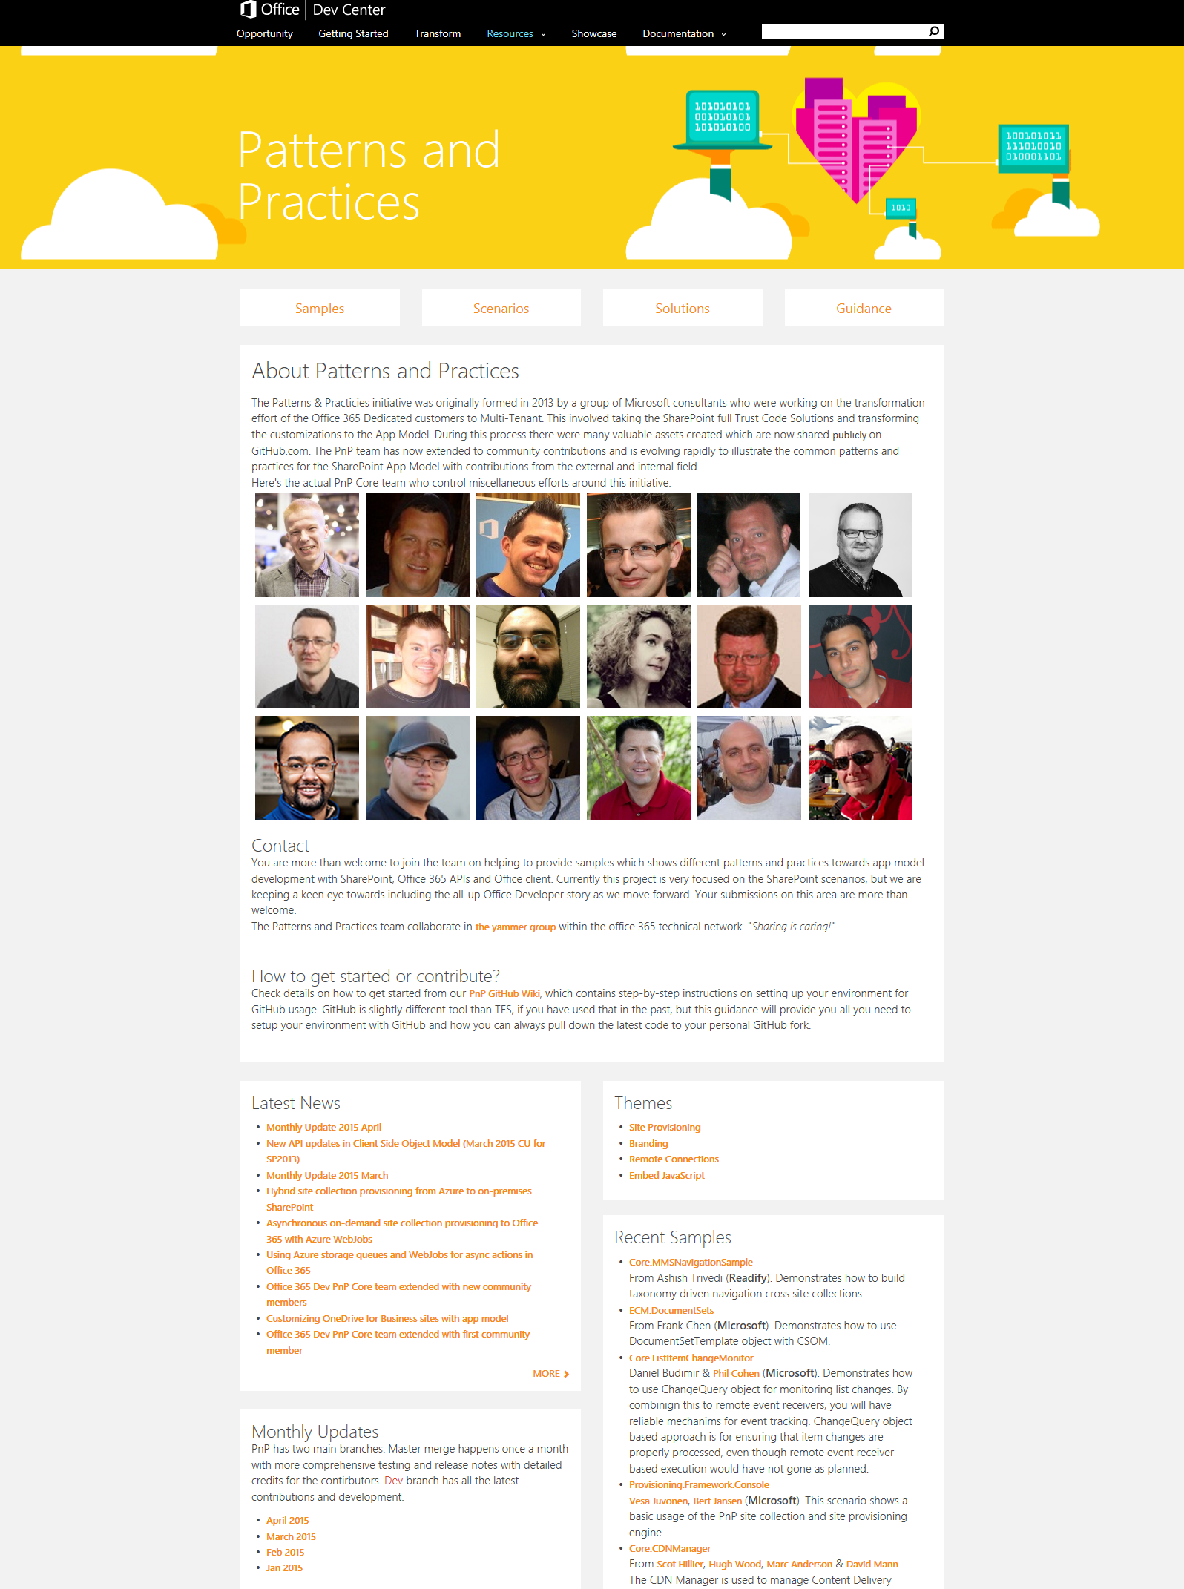
“Sharing is caring”
Ready to use App Model patterns for common scenarios
Open source and based on community contributions
Constantly evolving set of material for reuse
aka.ms/OfficeDevPnP
aka.ms/OfficeDevPnPYammer
aka.ms/OfficeDevPnPMSDN
aka.ms/OfficeDevPnPVideos
aka.ms/OfficeDevPnPTraining

Slide 12


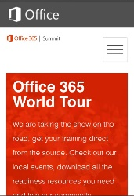
dev.office.com
Sign up
http://dev.office.com/getting-started
Explore
http://apisandbox.msdn.microsoft.com
Get trained http://dev.office.com/training

Slide 13


Feedback
Office 365 Network Share you best practices and join conversations
https://www.yammer.com/itpronetwork
Stackoverflow Ask deep technical questions to a world-wide set of developers
http://stackoverflow.com/questions/tagged/ms-office
User Voice Provide suggestions of what you want in future versions
http://officespdev.uservoice.com/

Slide 14


© 2015 Microsoft Corporation. All rights reserved. Microsoft, Windows, and other product names are or may be registered trademarks and/or trademarks in the U.S. and/or other countries.
The information herein is for informational purposes only and represents the current view of Microsoft Corporation as of the date of this presentation. Because Microsoft must respond to changing market conditions, it should not be interpreted to be a commitment on the part of Microsoft, and Microsoft cannot guarantee the accuracy of any information provided after the date of this presentation. MICROSOFT MAKES NO WARRANTIES, EXPRESS, IMPLIED OR STATUTORY, AS TO THE INFORMATION IN THIS PRESENTATION.

